Slide 1
The Simple Past Tense of Regular Verbs
Form (structure)
Meaning & Use
Pronunciation

Slide 2
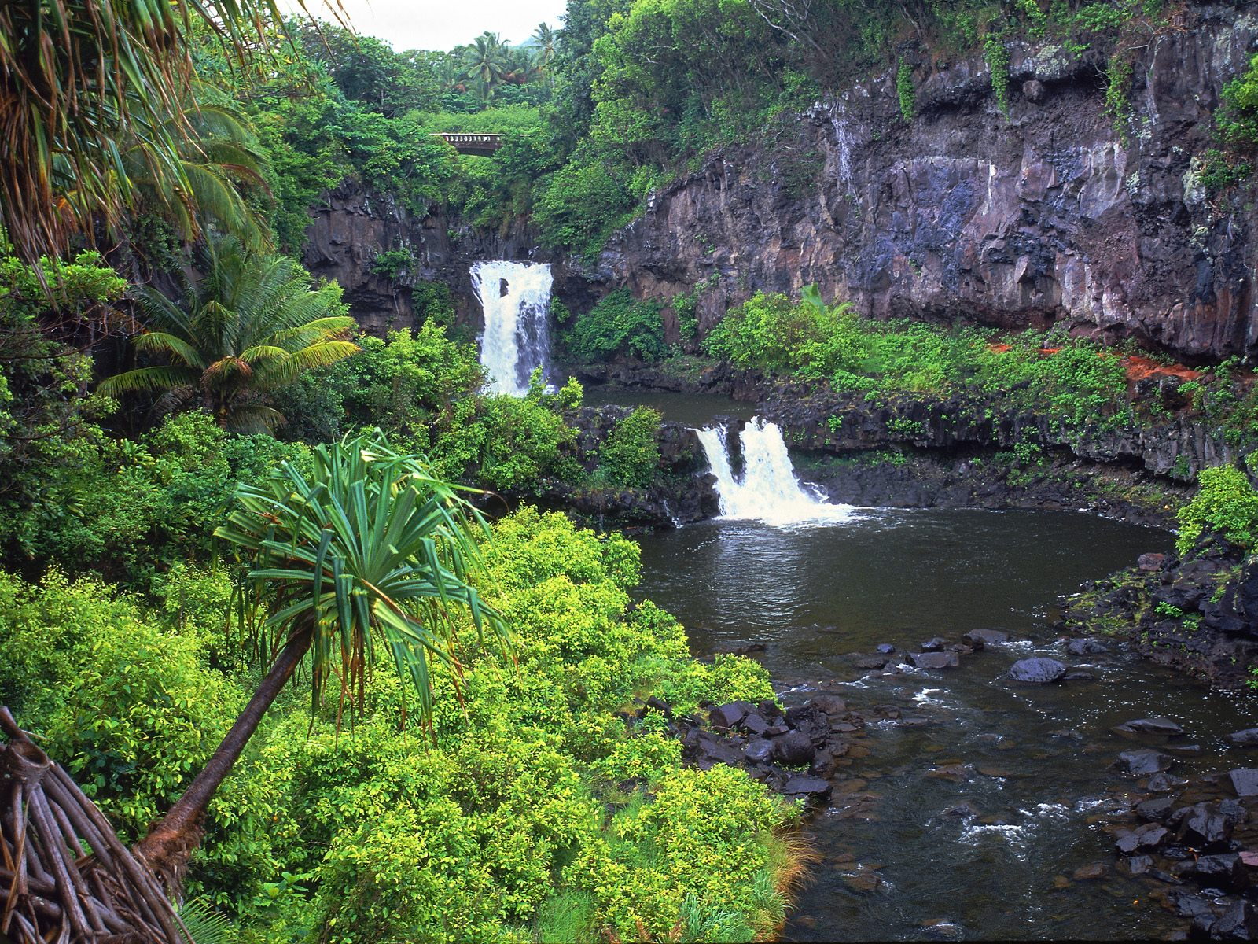
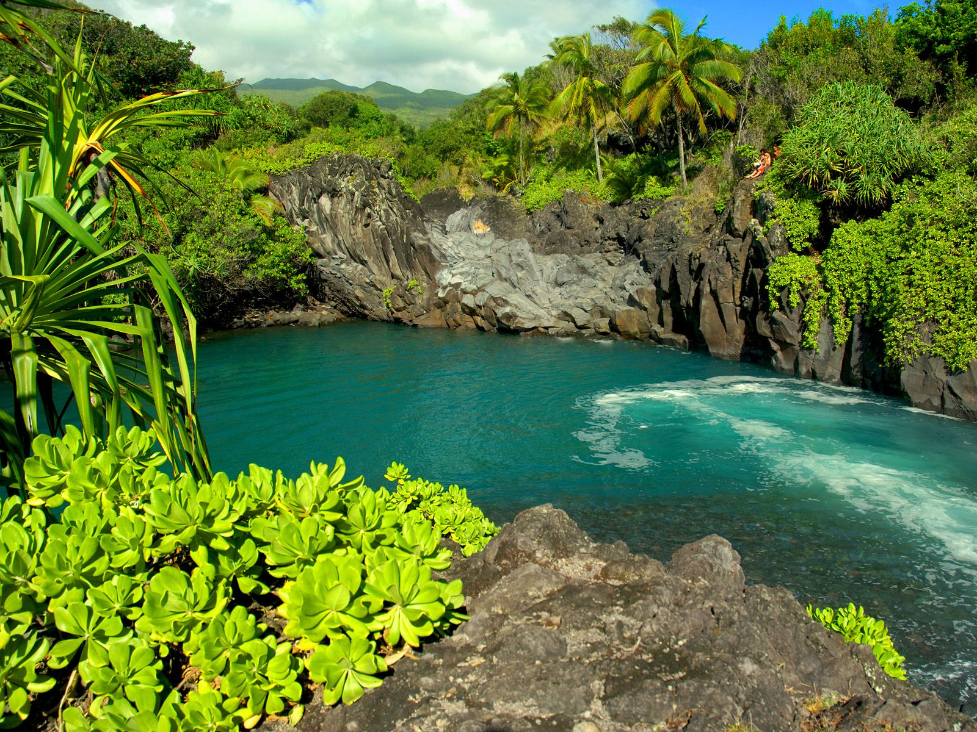
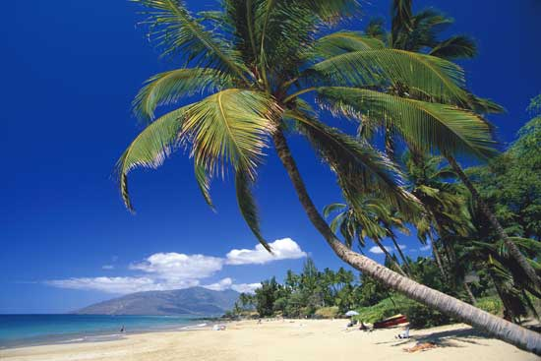
I love to travel. When I lived in the U.S. I traveled to different places, I visited Las Vegas, Los Angeles, Salt Lake City, Atlanta, Myrtle Beach, Reno, Lake Tahoe, Denver and Maui. The best place was Maui. I loved everything there. The weather was warm and sunny. Sometimes it rained but after the rain, it was sunny again. One time there was a double rainbow after it rained, it was beautiful.

Slide 3
Regular verbs are verbs that ….
…end with –ed
Simple Form Past Tense
Walk
Play
Cry
Live
walk
ed
play
ed
cri
ed
liv
ed

Slide 4
For regular verbs, simply use the –ed form of the verb in a positive sentence.
played
When I was a child, Liz ___________ the piano.
Donna ______________ and _______________ in Paris when she was a child.
lived
studied
**Be careful with
spelling changes!

Slide 5
For negative sentences, USE
did not
verb,
simple
form
+
or
I studied architecture.
I didn’t study medicine because I like to design.
didn't

Slide 6
Pronunciation
of regular verbs
The –ed ending in English has:
3 different sounds
d
t
id

Slide 7
Some regular verbs end with a “t” sound:
walked
laughed
washed
talked
jumped

Slide 8
Some regular verbs end with a “d” sound:
planned
played
learned
answered
loved

Slide 9
Other regular verbs end with an “id” sound:
These verbs have an extra syllable:
Simple Form Past Tense
invite
invited
wait
waited
decide
decided

Slide 10
There are rules that tell us how to pronounce the -ed.
However,
It’s a good idea for students to make a list of which –ed verbs have a “t” sound, which have a “d” sound, and which have an “id” sound.
And with practice, you can start to learn and memorize correct pronunciation.

Slide 11
I love to travel.
In the U.S. I traveled to different places.
I visited Las Vegas, Los Angeles, Salt Lake City, Atlanta, Myrtle Beach, Reno, Lake Tahoe, Denver and Maui.
The best place was Maui. I loved everything there.
The weather was warm, sunny.
It rained sometimes.
One time there was a double rainbow.
The double rainbow was beautiful.

Slide 12
Are these sentences correct?
I was visited Cusco.
They were looked at me..
She was cooked ceviche.
NO !!!
I visited Cusco.
They looked at me.
She cooked ceviche.
What is the problem?

